Slide 1
LASER SECURITY SYSTEM
- USING ARDUINO

Slide 2
Introduction
Components required
Circuit diagram
Experimental setup
Working
Uses and advantages
conclusion

Slide 3
INTRODUCTION:
• Security is the most important factor today.
Technology develops day by day in the world. The
crime gang also improves their technology to
perform their operation.
• So technology of security should modern with
time to protect the crime works. We decided to
make a security
• Project as our project. In this project we have
used the laser light to cover a large area.

Slide 4
We know laser light goes through long distance
with out scattering effect. It’s also visible at
source and at incident point, otherwise invisible.
• These two properties helps us to build up a
modern security system, which may name as
“laser security”.
• When any person or object or cross over the
laser line the security alarm will ring and also
the focus light will “on” to focus the entrance
of unauthorised person. We can make a
security boundary of single laser light by using
mirror at every corner for reflection

Slide 5
Components/materials required:
Breadboard
Buzzer(piezo alarm)
Jumper wires
Ldr (PHOto cells)
Resistors
Laser
Led(for indication)
Arduino uno
Usb cable(for uno connection via pc)
Arduino software

Slide 6
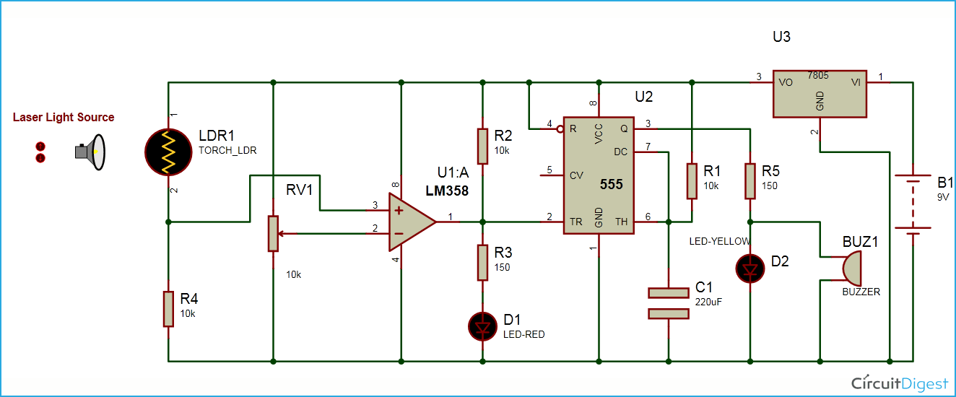
CIRCUIT DIAGRAM

Slide 7
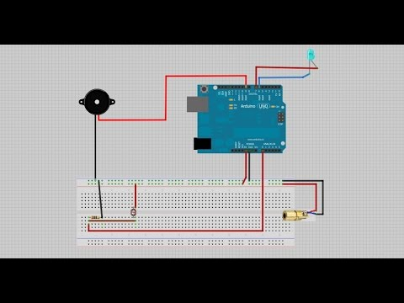
experimental - setup

Slide 8
WORKING :
Connect a photocell to a 5K resistor.This will pick up the
laser light and enable the alarm.
• Use a 2N7000 transistor to link the resistor. The attached
schematic should demonstrate how the parts come together.
Use a breadboard to hold them in place and make sure the
board is small enough to fit into a project box. Do not connect
the battery yet.
• Use tape, glue or strips to Velcro to mount the project box on
either side of the door you wish to protect.
• Connect a 9V battery to the first project box and replace it in
the exact position is was in.
• Turn the laser on with the toggle switch and make sure it lines
up perfectly with the photo cell.The alarm is now activated. If
any thing breaks the beam, the siren will go off.

Slide 9
ADVANTAGES & USES OF LASER SECURITY SYSTEM :
USAGIN ANTI-THEFT PURPOSE
IN MULTINATIONAL COMPANIES PURPOSE
PROTECTION FROM THEIVES
SECURITY PROTOCOLS SUCH AS IN FIELD OF: BANK SECTORS , PRIVEATE SECTORS,HOME,ETC.
THIEF DETECTION

Slide 10
conclusion
1)Home security is rapidly growing field and there
are
new & improved burglar alarms popping up every
day.
2)With rapid advancement of technology the field is
turning out to be an area full of scope and new
changes can be made to make it’s more efficient.
3) It has years to come, because security is of prime
importance to one and all.

Slide 11
THANK YOU

